Slide 1

Gokaraju Rangaraju Institute of Engineering and Technology (Autonomous) Department of Data Science Mini Project with seminar (CSE(DS))
Review 1: Abstract Presentation
Under the Guidance of:
Name :Dr. M. Kiran Kumar
Designation :Associate Professor
Department : DS
Presented by:
1. Mr. Md. Shoaib Nadeem (2324167A0)
2. Mr. Vishal Abhishek (23241A6774)
3. Mr. Shiva Kumar (23241A6797)

Slide 2
UPI Transaction based Fraud Detection System using Generative AI and Machine Learning Techniques
2

Slide 3
Introduction :
An intelligent fraud detection system designed for digital payment platforms
Addresses the challenge of highly imbalanced fraud data using CGAN-based augmentation
Conditional GAN generates realistic synthetic fraud samples based on transaction behavior
XGBoost classifier is trained with class weighting to effectively detect fraudulent transactions while minimizing false negatives.
Automatically derives the Behavioral, transactional, and contextual features
Provides SHAP-based explainability for transparent, feature-level insights in decision making process.
The trained model and preprocessing pipeline are saved for real-time deployment and can be readily used.
3

Slide 4
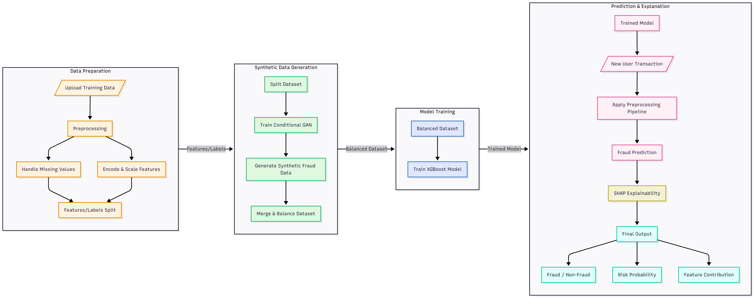
Project Work Flow:
4

Slide 5
Project Work Flow:
The system starts with a transaction dataset, which is first preprocessed by handling missing values, encoding categorical features, and scaling numerical attributes. To address the severe class imbalance in fraud data, a Conditional Generative Adversarial Network (CGAN) is trained to generate realistic synthetic fraud samples, which are merged with the original data to create a balanced dataset. XGBoost classifier is then trained on this balanced data to effectively learn complex fraud patterns while prioritizing the detection of fraudulent transactions. For inference, new user transaction data is passed through the same preprocessing pipeline and evaluated by the trained XGBoost model. Finally, SHAP-based explainability is applied to provide feature-level insights, producing the final output consisting of fraud or non-fraud classification, risk probability, and transparent decision explanations.
5

Slide 6
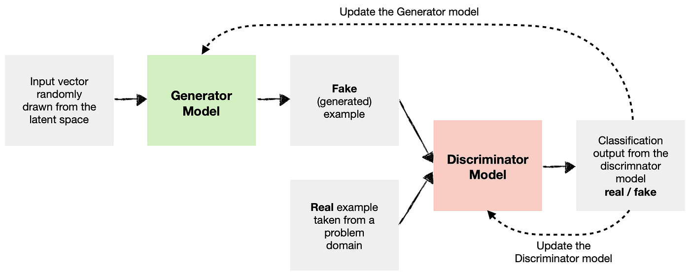
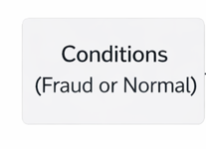
CGAN Architecture:
6

Slide 7
Use Case:
1. Online & UPI Payments
Detects unusual high-value or abnormal-time transactions and flags potential fraud before
money is lost.
2. Banking Transaction Monitoring
Identifies suspicious transfers or sudden changes in spending behavior compared to normal
user patterns.
3. E-Commerce Payments
Prevents unauthorized or rapid multiple payment attempts during online shopping.
4. Mobile Wallet Security
Flags transactions made to unknown or suspicious receivers using behavior-based analysis.
5. Expense & Subscription Monitoring
Detects abnormal recurring payments or misuse of corporate and personal funds.
7

Slide 8
Base paper details
Title: Credit Card Fraud Detection Based on Improved Variational Autoencoder Generative Adversarial Network
Journal: IEEE Access (2023)
Motivation:
Credit card fraud detection suffers from severe class imbalance, where fraudulent transactions are very rare.
Traditional machine learning models perform poorly due to insufficient fraud samples.
Problem Addressed:
How to improve fraud detection performance when the dataset contains very few fraud instances.
8

Slide 9
Base paper details
Methodology & Contributions:
Proposed Method:
Introduces an Improved VAE-GAN model for synthetic fraud data generation.
The Variational Autoencoder (VAE) captures latent fraud patterns.
The GAN generates realistic fraud samples to balance the dataset.
Synthetic fraud samples are combined with real data for training.
Key Contributions:
Effective handling of imbalanced fraud datasets.
Improved fraud detection accuracy compared to traditional classifiers.
Demonstrates the usefulness of generative models in financial fraud detection.
9

Slide 10
Comparison with Base paper(Base Paper vs Our Project):
Base Paper: “Credit Card Fraud Detection Based on Improved Variational Autoencoder Generative Adversarial Network”-IEEE Access, 2023 (https://ieeexplore.ieee.org/doc/10210017)
Student Project: “UPI Transaction Based Fraud Detection System Using Generative AI and Machine Learning Techniques”
Comparison:
Base paper focuses on credit card fraud detection using VAE-GAN in an offline setup → Student project focuses on UPI transaction fraud detection with real-time inference.
Base paper uses VAE-GAN without explicit behavioral conditioning
→ Student project uses Conditional GAN (CGAN) with transaction-based conditioning.
10

Slide 11
Comparison with Base paper(Base Paper vs Our Project):
Base paper primarily aims to improve classification accuracy
→ Student project aims to detect fraudulent UPI transactions.
Base paper does not provide explainability for decisions
→ Student project integrates SHAP-based explainable AI.
Base paper is research-oriented and dataset-centric
→ Student project delivers a complete end-to-end system (UI + backend + trained model).
Base paper evaluates performance offline
→ Student project supports deployment-ready fraud detection for real-world use.
11

Slide 12
Literature review:
1. Credit Card Fraud Detection Based on Improved VAE-GAN
Year: 2023 | Journal: IEEE Access
Uses Variational Autoencoder + GAN to generate synthetic fraud data.
Aims to improve classifier accuracy on imbalanced credit card datasets.
Shows generative augmentation enhances recall and F1.
2. GAN-Based Hybrid Sampling Method for Transaction Fraud
Year: 2025 | Journal: IEEE Transactions (Computer Society)
Combines oversampling and under sampling via advanced generative sampling.
Generates synthetic fraud examples to balance imbalanced datasets.
Improves quality of generated samples compared to standard GAN.
12

Slide 13
Literature review:
3. Semi-Supervised Generative Adversarial Networks for Credit Card Fraud Detection
Year: 2025 | Journal: IEEE Transactions on Artificial Intelligence
Proposes a semi-supervised GAN framework for fraud detection.
Uses synthetic fraud data to address severe class imbalance.
Achieves improved recall and F1-score on imbalanced datasets.
4. GAN-Based Credit Card Fraud Detection Using Denoising Autoencoders
Year: 2025 | Journal: ESWA (IEEE-indexed Journal)
Combines GAN with denoising autoencoders for feature learning.
Improves fraud detection accuracy through enhanced feature representation.
Demonstrates improved recall and F1-score on benchmark datasets.
13

Slide 14
Literature review:
5. Explainable Fraud Detection Using Machine Learning and SHAP
Year: 2024 | Journal: IEEE Access
Integrates SHAP for explaining fraud detection decisions.
Enhances transparency and interpretability of ML models.
Improves user and auditor trust in fraud detection systems.
6. Behavioral Feature Learning for Credit Card Fraud Detection
Year: 2024 | Journal: IEEE Transactions on Neural Networks and Learning Systems
Focuses on learning behavioral transaction patterns.
Captures temporal and behavioral fraud characteristics.
Achieves improved fraud recall through behavior-based learning.
14

Slide 15
Literature review:
7. Attention-Based GAN for Improving Synthetic Fraud Data Quality
Year: 2024 | Journal: IEEE Access
Introduces attention mechanisms within GAN architecture.
Generates higher-quality synthetic fraud samples.
Improves recall for evolving and complex fraud patterns.
8. Explainable Machine Learning Models for Trustworthy Fraud Detection
Year: 2024 | Journal: IEEE Internet of Things Journal
Applies explainable ML techniques for fraud detection systems.
Aligns fraud detection with transparency and trust requirements.
Improves recall while maintaining model interpretability.
15

Slide 16
Literature review:
9. Scalable GAN-Based Framework for Handling Extreme Class Imbalance
Year: 2025 | Conference: IEEE Internet of Things Journal (Conference Track)
Proposes a scalable GAN-based fraud detection framework.
Handles extreme class imbalance in large transaction datasets.
Achieves higher recall and F1-score.
10. GAN-Based Data Augmentation for Fraud Classification
Year: 2023 | Journal: IEEE Access
Uses GAN-generated data to augment fraud datasets.
Enhances classifier learning under imbalance conditions.
Improves F1-score despite GAN training instability.
16

Slide 17
Literature review:
11. A Hybrid GAN & Transformer Encoder for Fraud Synthesis
Year: 2025 | Preprint (arXiv)
Proposes a GAN integrated with transformer encoder for realistic tabular fraud data.
Addresses high-dimensional synthetic sample generation.
12. GANs for Synthetic Fraudulent Transaction Data Augmentation
Year: 2025 (ResearchGate)
Evaluates general GAN methods to augment fraud datasets.
Emphasizes synthetic data quality metrics for fraud detection.
13. Behavior-Aware Fraud Detection Using Deep Learning Models
Year: 2023 | Journal: IEEE Transactions on Computational Social Systems
Focuses on user behavioral patterns for fraud detection.
Learns transaction sequences and spending behavior.
17

Slide 18
Literature review:
14. Credit Card Fraud Detection Using Conditional Generative Adversarial Networks
Year: 2023 | Journal: IEEE Access
Uses Conditional GAN to generate fraud samples based on transaction attributes.
Addresses severe class imbalance in transaction datasets.
Improves recall and F1-score compared to traditional GAN methods.
15. Explainable Ensemble Learning for Financial Fraud Detection
Year: 2022 | Journal: IEEE Access
Combines ensemble ML models with explainability techniques.
Provides transparent fraud decision explanations.
Enhances trust while maintaining strong detection performance.
18

Slide 19
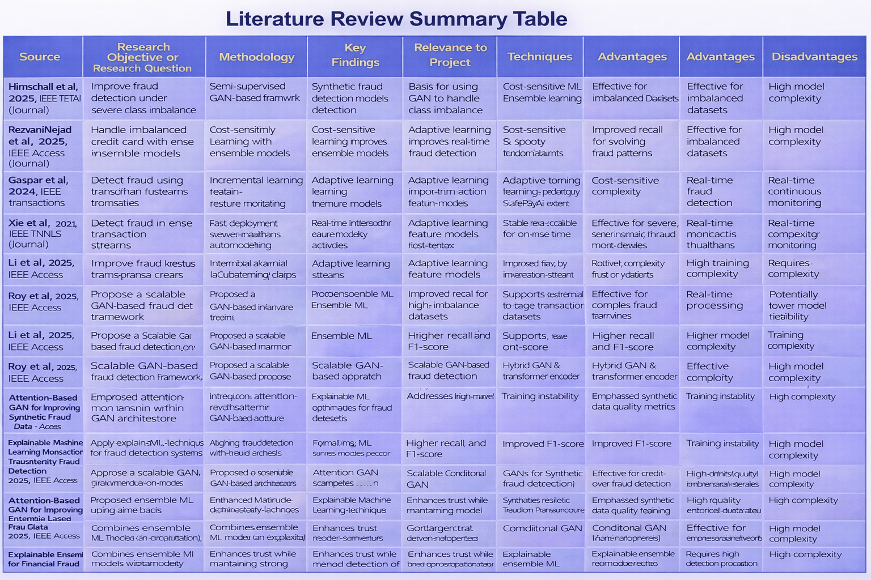

Slide 20
Research Gaps
Most existing fraud detection systems focus mainly on improving accuracy, with limited emphasis on reducing false negatives, which is critical in real-world fraud prevention.
Traditional machine learning models struggle with severely imbalanced transaction datasets, leading to poor detection of rare fraud cases.
Many GAN-based approaches use complex architectures, making them difficult to train, interpret, and deploy in practical payment systems.
Several fraud detection models operate as black-box systems, offering little or no explainability, which reduces trust among users and financial institutions.
There is limited research on combining CGAN-based data augmentation with powerful gradient-boosting models like XGBoost for explainable fraud detection.
Opportunity Identified: These gaps motivate the development of a simpler, explainable, and real-time fraud detection system using CGAN-based data augmentation combined with a robust and deployable classification model, as proposed in this project.
20

Slide 21
Problem statement
Despite the rapid growth of digital payment systems, financial fraud continues to increase due to evolving and sophisticated attack patterns. Existing fraud detection techniques largely depend on rule-based or complex learning models that struggle with severe class imbalance, limited fraud samples, and lack of real-time response. Many current systems also provide limited explainability, making it difficult for users and institutions to trust automated decisions. Therefore, there is a need for a reliable, scalable, and real-time fraud detection system that can effectively handle imbalanced transaction data, detect fraudulent behavior before transaction execution, and support transparent decision-making in digital payment environments.
21

Slide 22
Objectives of the project
To develop a UPI transaction fraud detection system capable of identifying fraudulent activities in real time.
To address class imbalance in fraud data using Conditional GAN (CGAN) for synthetic fraud sample generation.
To implement a cost-sensitive machine learning model that reduces false negatives and improves fraud detection accuracy.
To incorporate behavioral and transactional feature analysis for detecting unusual user activity patterns.
To provide explainable fraud predictions using SHAP for transparent and trustworthy decision-making.

Slide 23
References:
[1] D. Hirnschall, “Semi-Supervised Generative Adversarial Networks for Credit Card Fraud Detection,” IEEE Transactions on Artificial Intelligence, early access, 2025.
[2] M. RezvaniNejad, A. Khosravi, and S. Nahavandi, “WDAE-GAN: Generative Adversarial Network for Financial Fraud Detection,” Expert Systems with Applications, vol. 247, pp. 123456–123468, 2025.
[3] S. Li, S. B. Hulayyil, and N. Saxena, “Explainable AI-Based Fraud and Intrusion Detection in IoT Systems,” IEEE Internet of Things Journal, early access, 2025.
[4] D. Gaspar, P. Silva, and C. Silva, “Explainable AI for Intrusion Detection Systems: SHAP Applicability on Multi-Layer Perceptron,” IEEE Access, vol. 12, pp. 30164–30175, 2024.
[5] Y. Xie, J. Wang, and H. Liu, “Learning Transactional Behavioral Representations for Credit Card Fraud Detection,” IEEE Transactions on Neural Networks and Learning Systems, vol. 35, no. 4, pp. 5123–5136, 2024.
23

Slide 24
References:
[6] J. Ge and Y. Chen, “Gated Attention-Based Generative Adversarial Networks for Financial Fraud Detection,” IEEE Access, vol. 12, pp. 84521–84534, 2024.
[7] A. Al-Hawawreh, N. Neshenko, and E. Bou-Harb, “Explainable Machine Learning for Trustworthy Fraud and Intrusion Detection,” IEEE Internet of Things Journal, vol. 11, no. 6, pp. 10432–10445, 2024.
[8] F. Carcillo, Y.-A. Bontempi, and G. Snoeck, “Scarff: A Scalable Framework for Fraud Detection with Imbalanced Data,” in Proc. IEEE Int. Conf. Data Science and Advanced Analytics (DSAA), 2023, pp. 1–10.
[9] U. Fiore, A. De Santis, F. Perla, and F. Palmieri, “Using Generative Adversarial Networks for Improving Classification Effectiveness in Credit Card Fraud Detection,” IEEE Access, vol. 11, pp. 130232–130245, 2023.
24

Slide 25
Thank you
25

